Slide 1
A Bad Design Battlefield 2042
Joseph Casetta

Slide 2
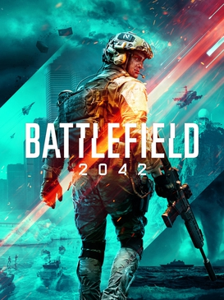
Battlefield 2042
Developed by Dice, published by Electronic Arts (EA)
Average player count (Steam) in the last thirty days, 9,763
Battlefield V, release date 2018, average player count, 10,761

Slide 3
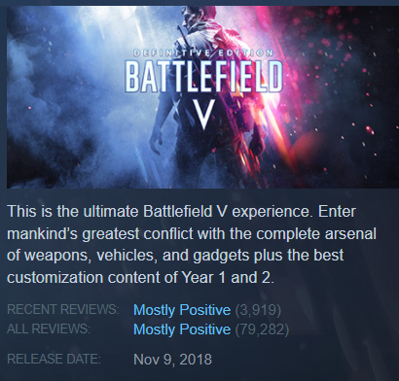
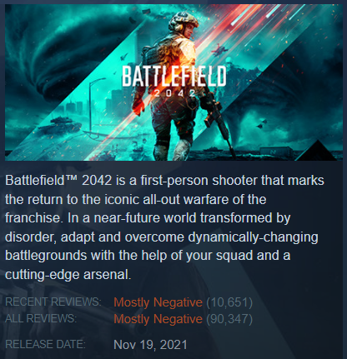
Gameplay and Features
No server browser
No scoreboard
No class system
Stat tracking
No squad changing
No clans
Fewer maps
No levelution
Poor balance
Less destructibility
Bad sound design
Empty maps
Less peripherals support

Slide 4
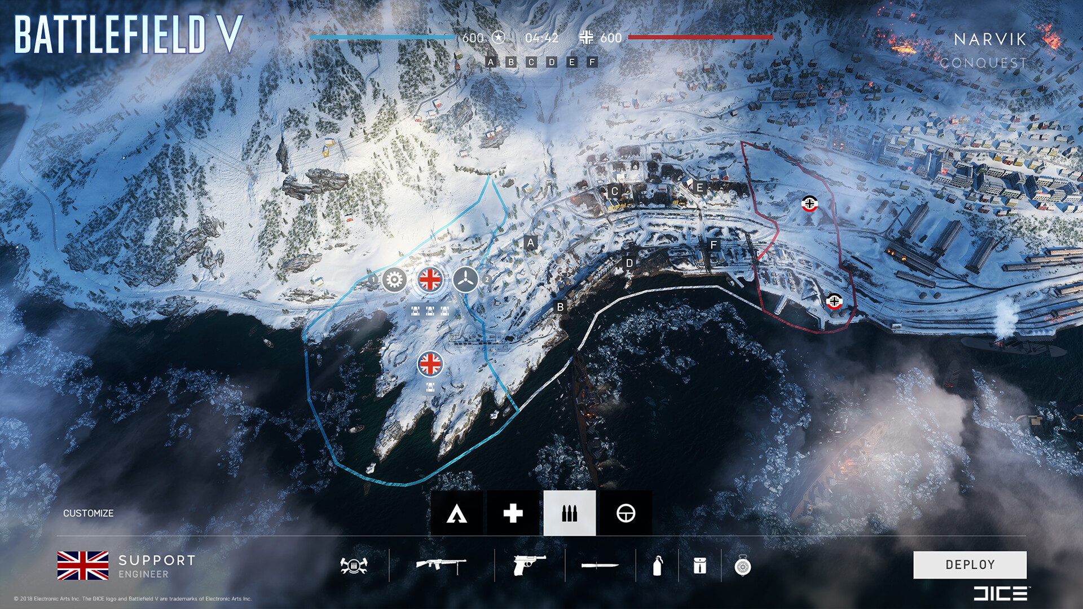
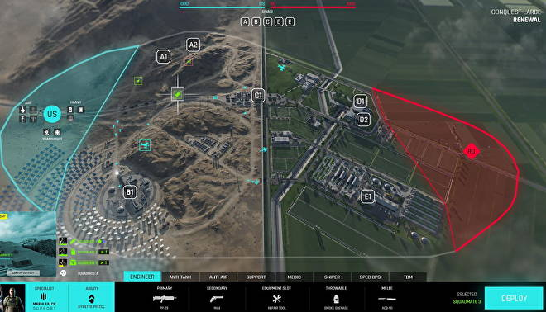
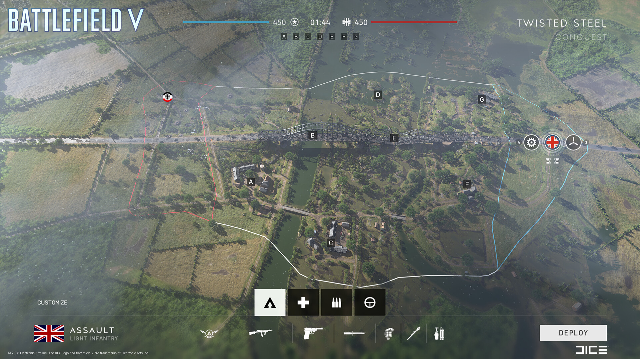
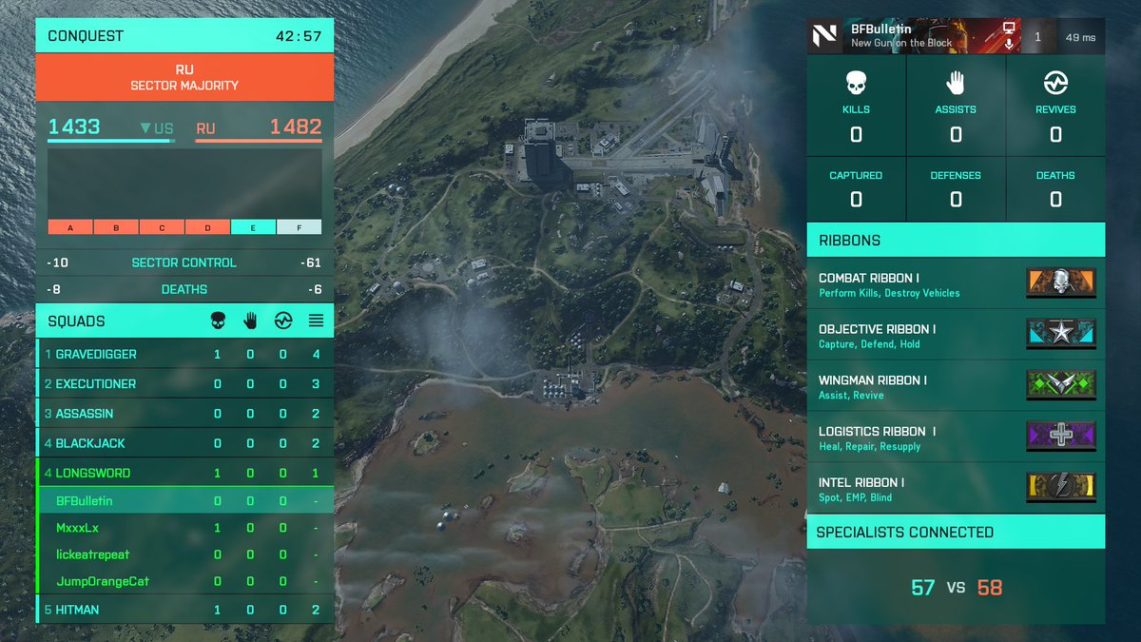
UI Design and Clutter

Slide 5
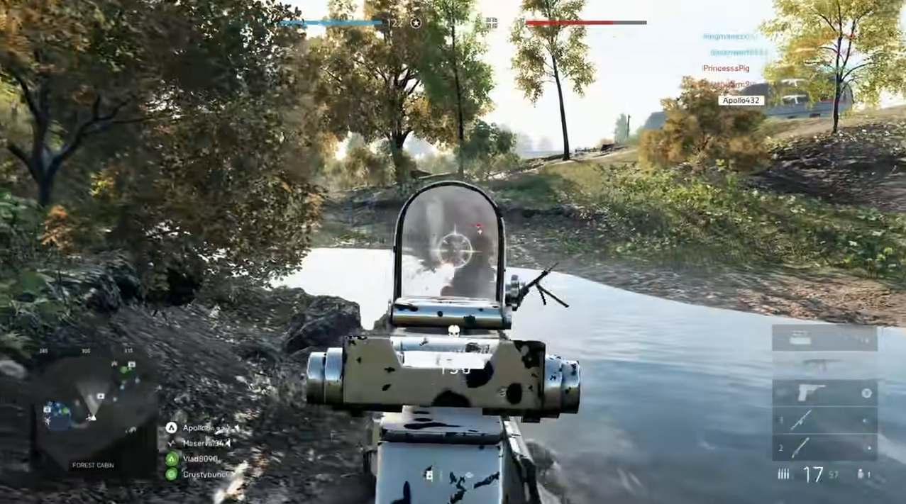

Slide 6
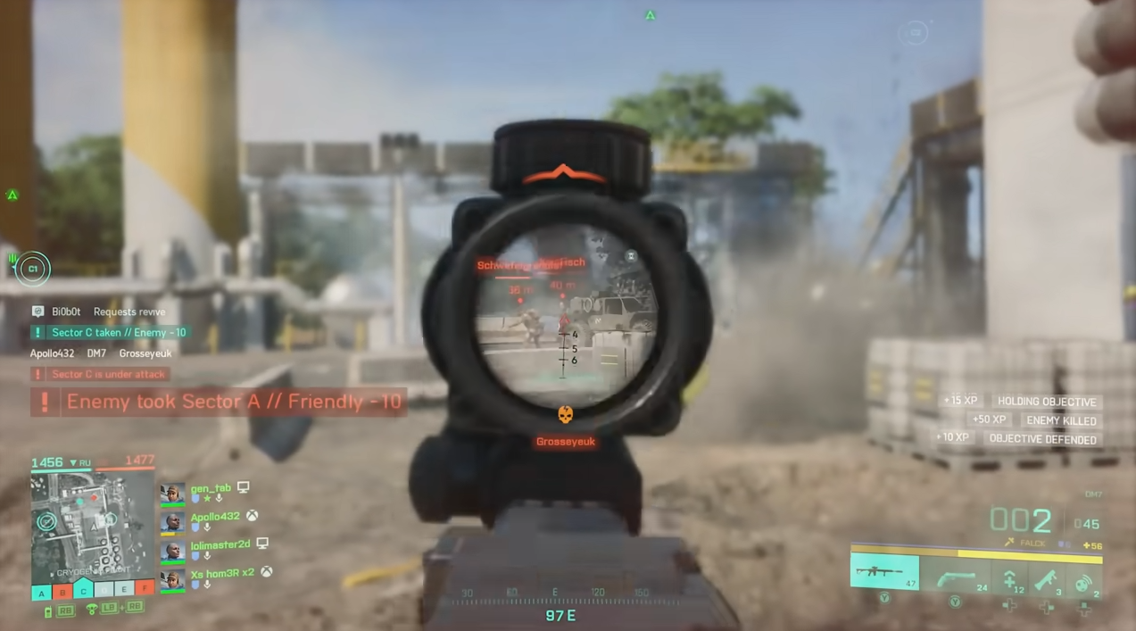

Slide 7
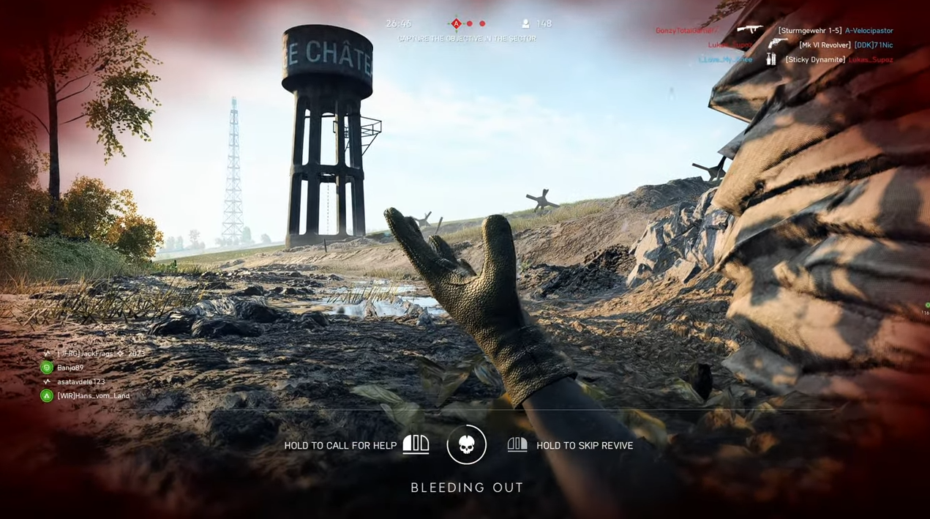

Slide 8
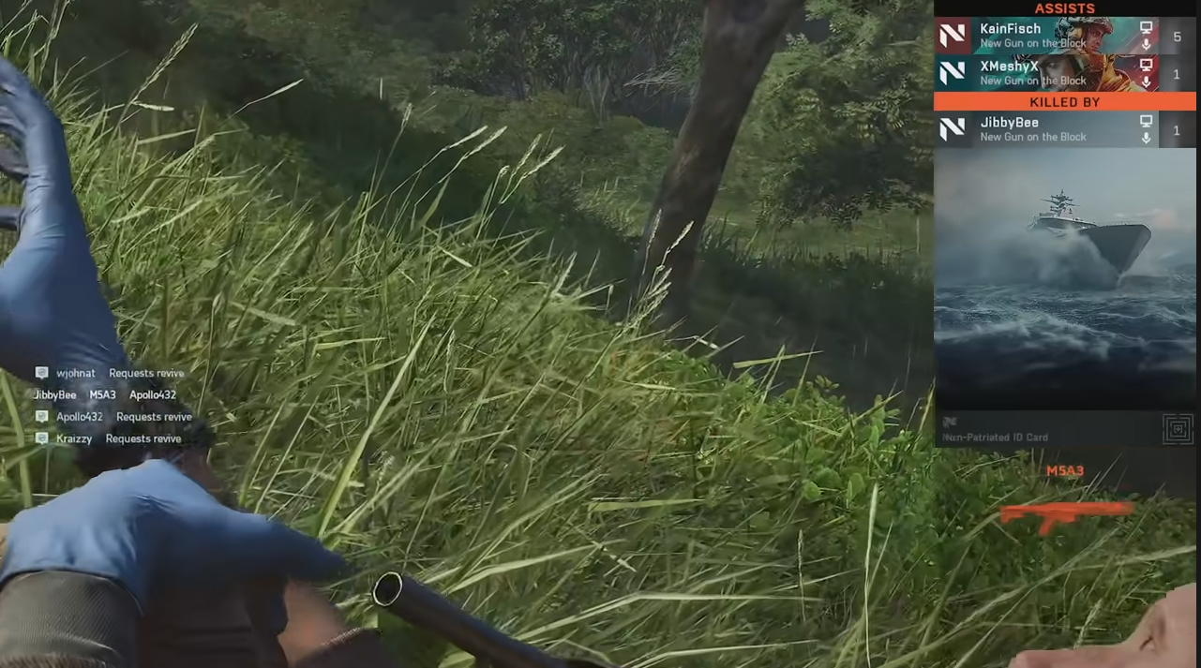

Slide 9
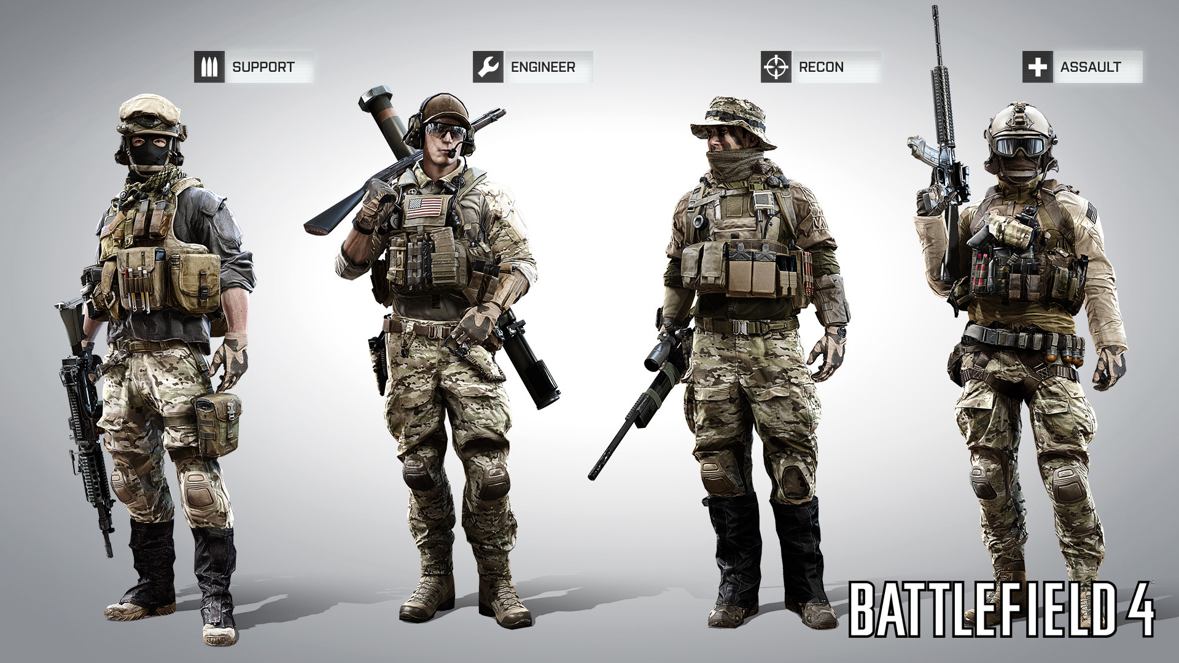
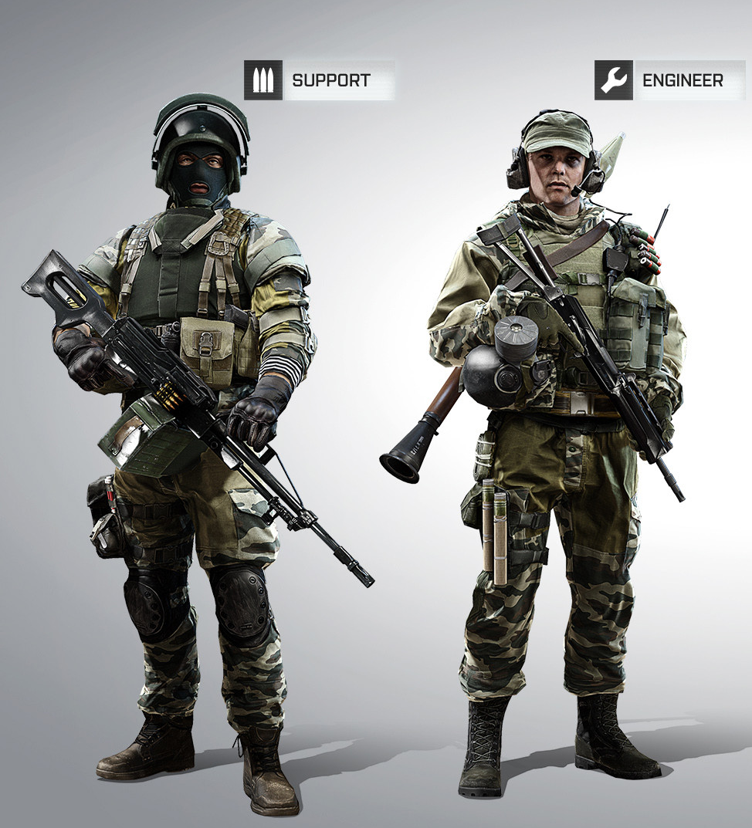
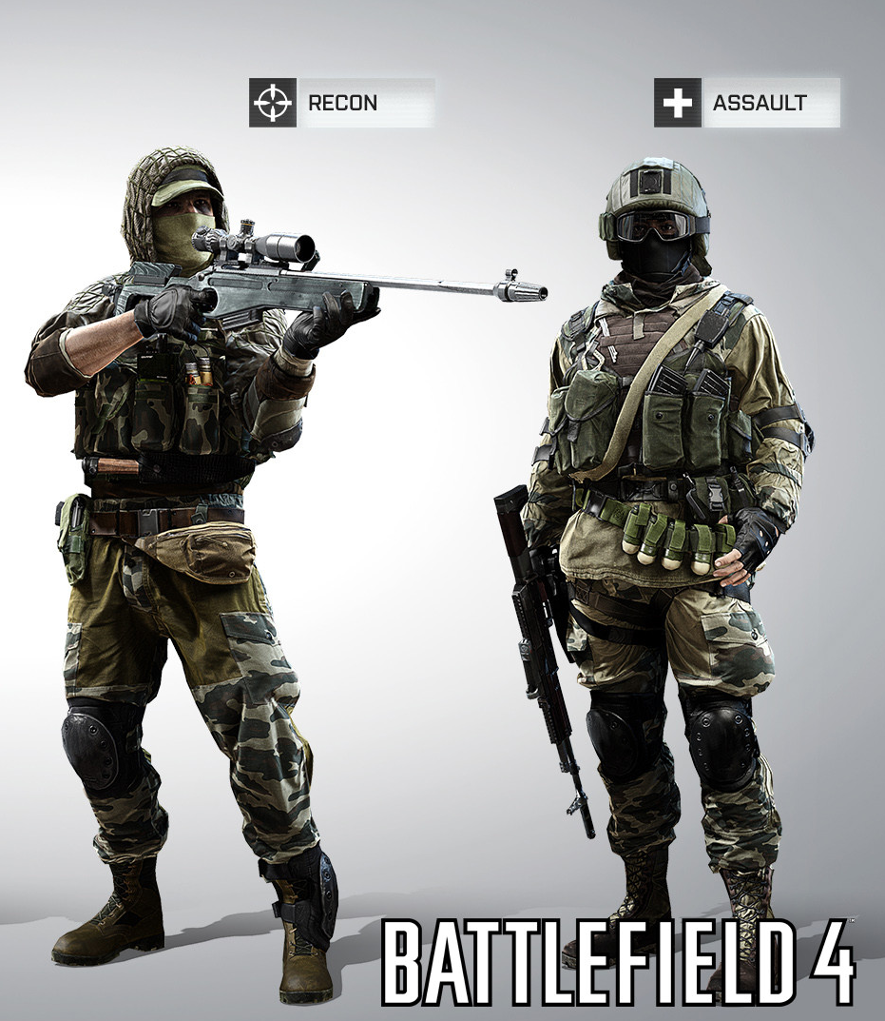
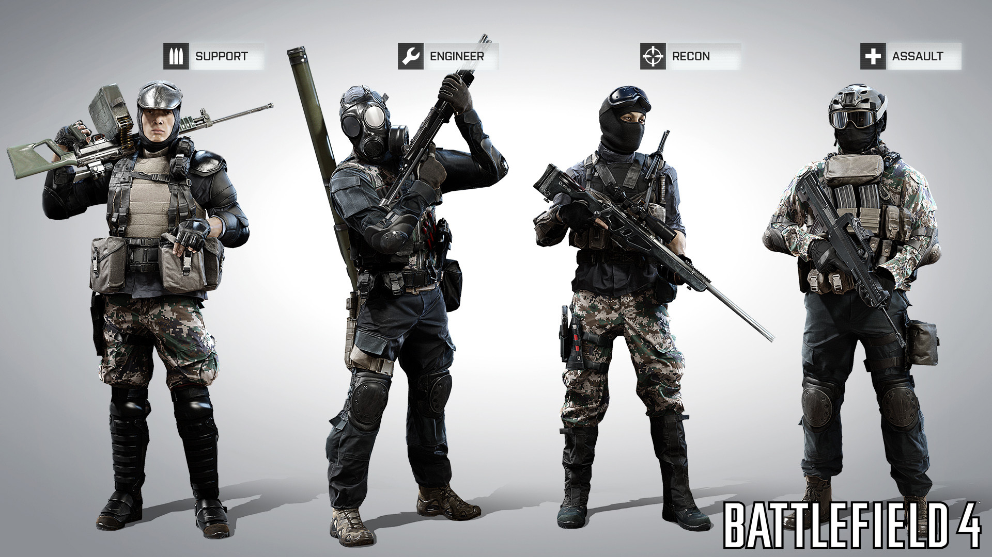
Visual Distinctiveness
Battlefield 4 Characters

Slide 10
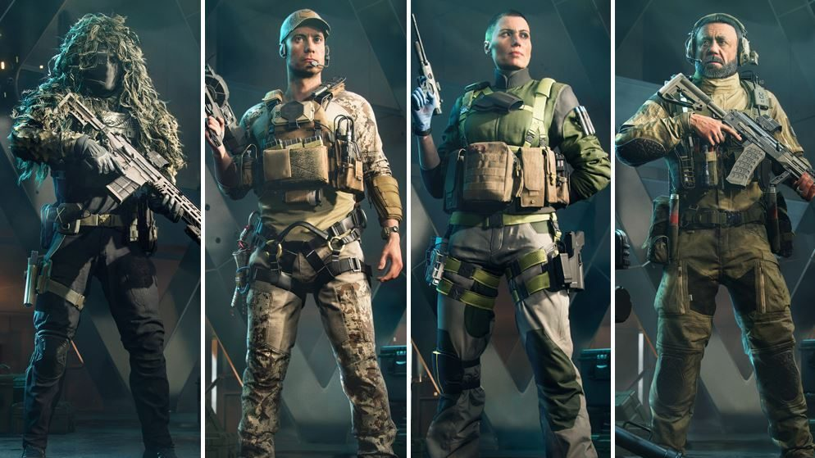
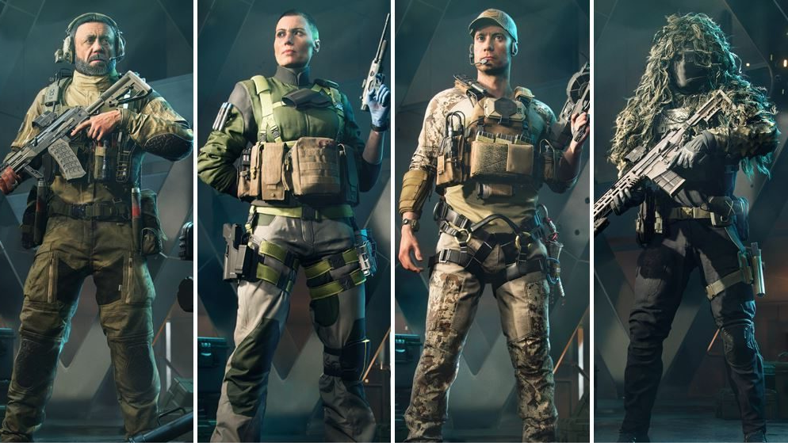
Visual Distinctiveness
VS
2042 Characters

Slide 11
All Missing Features
Core Features
No single-player story/campaign mode
No standard server browser
Fewer standardized game
No standard hardcore mode
No conventional scoreboard
No persistent lobbies
No class system
Less character customization options (than BF5)
No profile progress/stats page in the menu
No battle log/stats tracker for other players
No global leader boards
No dog tags
No custom emblems
No cross-game profile screen
No spectator mode
No permanent community servers
No Central US servers
No test
Vehicles
Fewer vehicle types
No naval vehicles
Cannot spawn in a passenger seat in transports at round start.
No vehicle gunner direction indicator
No lock on direction indicator
No unoccupied seat indicator on friendly vehicles
No vehicle enter/exit animations
Less vehicle driver/pilot customization options
No tank zoom customization options
No heli gunner secondary weapons
No separate heli/fixed-wing controls
No rocket impact reticle for helictopters
No option to toggle tank turret decoupling
No control input while looking behind/free looking in aircraft
No joystick/non-generic gamepad support
General consensus seems to be that the helicopter and fixed wing flight models are a step down from BF4.
Infantry Gameplay
Fewer guns Fewer infantry gadgets
No manual leaning
No diving while swimming
No moving during prone ADS
No high wall vaulting
No crouch sprinting
No backwards prone
No explosion knockback
No rolling after falling from heights
No "you are spotted" indication.
No ammo or health pickup off teammates
No scope zeroing
No tiered reloads/paused reloads
No thermal optics
No indirect fire gadgets
Less anti-tank launchers
No lock-on launchers
No AP mines/claymores
No suppression mechanic
No first person takedown animations
Scoring System
No squad wipe scoring
No player damage points
No vehicle damage points
No vehicle kill assist points
No laser designation kill assist points
No headshot bonus
No long-range kill/ marksman bonus
No assist counts as kill bonus
No multi-kill bonus
No killstreak stopped bonus
No comeback bonus
No squad objective play bonus
Oversimplified teamplay

Slide 12
All Missing Features Cont.
Squad and Teamwork
No commander
No special squad call-in abilities
No squad field upgrades
No in-game VOIP
Fewer factions
No cross-team chat
No team changing
No "create new squad" option
No option to switch squads
No self promote to squad lead using "request order"
No clans/platoons
No view of squadmates while in the spawn screen
Smaller squad size
No rank names/icons, just a number.
UI and Quality of Life
Less control customization options
Less UI customization options
No HUD/icon opacity customization
No HUD scaling customization options
No mini-map zoom scale
No elevation difference indication for enemies on mini map
No gunsight reticle customization options
No network performance graph
No individual player scoreboard
No ability to zoom in on the spawn map
Less ultrawide monitor support (hud ratio is locked in at 16:9)
Very poor friend joining system
Maps
Lack of persistent servers means poor map rotation
Fewer base game maps
No static weapon emplacements
Fewer destructible buildings
Very poor balance between vehicle and infantry gameplay
No infantry focused maps
No game changing levolution
Absolutely zero cover between capture zones
Poor spawn points
No fortification building
Fewer urban areas
No naval maps
Audio
General consensus seems to be the audio design is bad, especially compared to both BF3 and BF1.
3D soundscape is almost non-exsistent
Less impactful soundtrack (menu music is very dull and repetitive)
End of round music is dull and uninteresting (compared to BF1 and V this is a big downgrade)

Slide 13
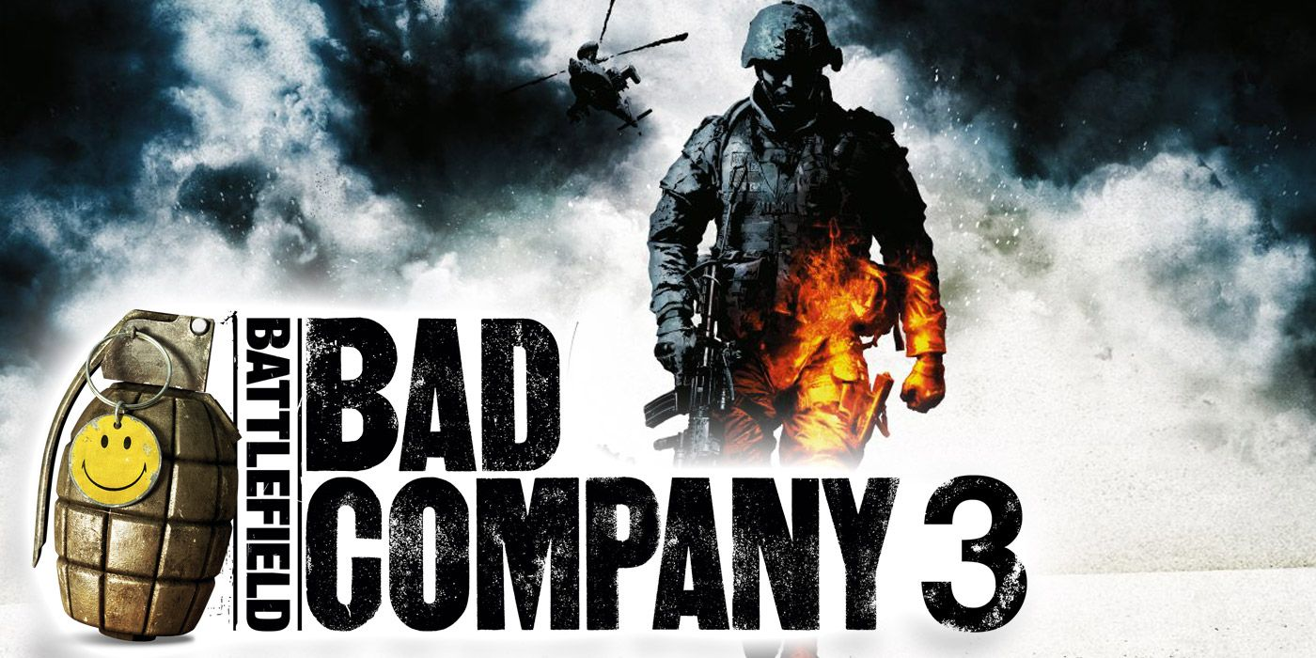
How to Fix
Bring back class systems
Faction specific aesthetics
Re-design UI
Less is more
Stop stripping features
Create product from the ground up
Set realistic time and work expectations
Listen to fans

Slide 14
A Bad Design Battlefield 2042
Joseph Casetta

